Slide 1
Implementation of RRt connect and RRT Star
Saandeep Sreerambatla , Vamsy Viswanath putta

Slide 2
Planned Activities
Creating a 6 DOF revolute robot and an environment with obstacles
Providing and q initial and q goal configuration for the robot to move.
Implementing RRT Connect
Implementing RRTStar
Explaining and understanding the algorithms
Questions

Slide 3
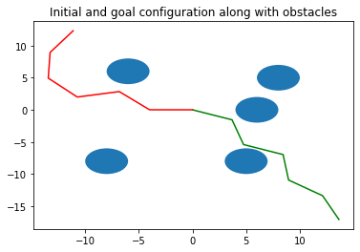
Environment
The below is the environment which is created

Slide 4
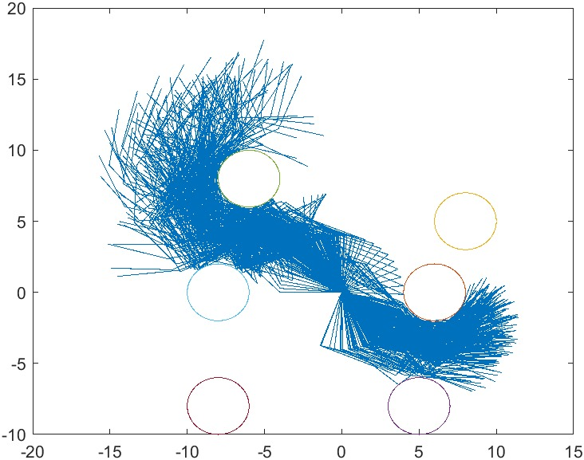
Implementing RRT Connect
The below is the graph which is the output of the RRT Connect

Slide 5
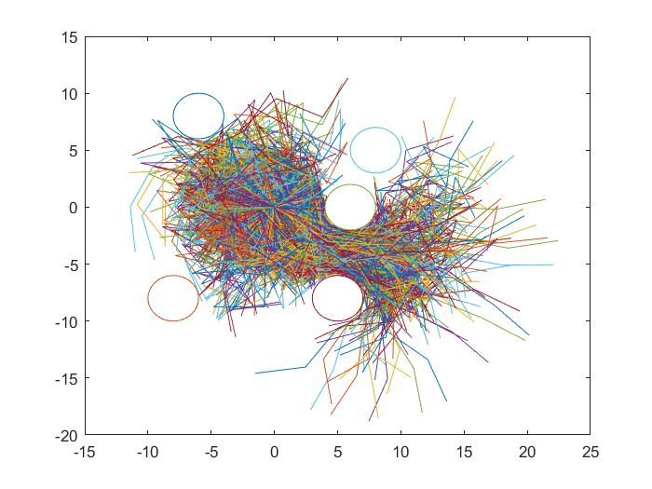
RRT Star
The below is the output from RRTStar

Slide 6
Results
RRT Connect converges faster compared to RRT Star
RRT Star takes more time and more nodes to converge , but it always gives the shortest path

Slide 7
questions

